Slide 1

Data Glacier Virtual Internship
Final Project – Customer Segmentation
Blessed Adjei-Gyan
13th January, 2025

Slide 2

Project | Customer Segmentation
Submitted By | Blessed Adjei-Gyan
Email | blessedadjei13@gmail.com
Country | Germany
Specialization | Data Analyst
Internship Batch | LISUM 39
Data | 13th January, 2025

Slide 3
Agenda
Problem Statement
Data Information
Data Understanding
Exploratory Data Analysis (EDA)
Modeling Technique
Recommendations

Slide 4
Problem Statement
1.Problem Description
XYZ bank wants to roll out Christmas offers to their customers. But Bank does not want to roll out same offer to all customers instead they want to roll out personalized offer to particular set of customers. If they manually start understanding the category of customer then this will be not efficient and also they will not be able to uncover the hidden pattern in the data (pattern which group certain kind of customer in one category). Bank approached ABC analytics company to solve their problem. Bank also shared information with ABC analytics that they don't want more than 5 group as this will be inefficient for their campaign.
2.Business Understanding
ABC analytics proposed customer segmentation approach to Bank. ABC analytics assigned this talk to their analytics team and instructed their team to come up with the approach and feature which group similar behavior customer in one category and others in different category.

Slide 5
Data Information
Total number of observations | 1000000
Total number of files | 1
Total number of features | 48
Base format of the file | csv
Size of the data | 154 MB
Total number of observations | 1000000
Total number of files | 1

Slide 6
fecha_dato: The table is partitioned for this column ncodpers: Customer code ind_empleado: Employee index: A active, B ex employed, F filial, N not employee, P pasive pais_residencia: Customer's Country residence sexo: Customer's sex age: Age fecha_alta: The date in which the customer became as the first holder of a contract in the bank ind_nuevo: New customer Index. 1 if the customer registered in the last 6 months. antiguedad: Customer seniority (in months) indrel: 1 (First/Primary), 99 (Primary customer during the month but not at the end of the month) ult_fec_cli_1t: Last date as primary customer (if he isn't at the end of the month) indrel_1mes: Customer type at the beginning of the month ,1 (First/Primary customer), 2 (co-owner ),P (Potential),3 (former primary), 4(former co-owner) tiprel_1mes: Customer relation type at the beginning of the month, A (active), I (inactive), P (former customer),R (Potential)
Data Information

Slide 7
indresi: Residence index (S (Yes) or N (No) if the residence country is the same than the bank country) indext: Foreigner index (S (Yes) or N (No) if the customer's birth country is different than the bank country) conyuemp: Spouse index. 1 if the customer is spouse of an employee canal_entrada: channel used by the customer to join indfall: Deceased index. N/S tipodom: Addres type. 1, primary address cod_prov: Province code (customer's address) nomprov: Province name ind_actividad_cliente: Activity index (1, active customer; 0, inactive customer)
renta: Gross income of the household ind_ahor_fin_ult1: Saving Account ind_aval_fin_ult1: Guarantees ind_cco_fin_ult1: Current Accounts ind_cder_fin_ult1: Derivada Account ind_cno_fin_ult1: Payroll Account
Data Information

Slide 8
ind_ctju_fin_ult1: Junior Account ind_ctma_fin_ult1: Más particular Account ind_ctop_fin_ult1: particular Account
ind_ctpp_fin_ult1: Particular Plus Account ind_deco_fin_ult1: Short-term deposits ind_deme_fin_ult1: Medium-term deposits ind_dela_fin_ult1: Long-term deposits ind_ecue_fin_ult1: e-account ind_fond_fin_ult1: Funds ind_hip_fin_ult1: Mortgage ind_plan_fin_ult1: Pensions ind_pres_fin_ult1: Loans ind_reca_fin_ult1: Taxes ind_tjcr_fin_ult1: Credit Card ind_valo_fin_ult1: Securities ind_viv_fin_ult1: Home Account ind_nomina_ult1: Payroll ind_nom_pens_ult1: Pensions ind_recibo_ult1: Direct Debit
Data Information

Slide 9
Task
1. Business Understanding
2. Data Understanding
3. EDA
4. Feature Engineering
4. Model Building
5. Model Evaluation
6. Presentation (Recommendation slide is must)
7. Document the challenges

Slide 10
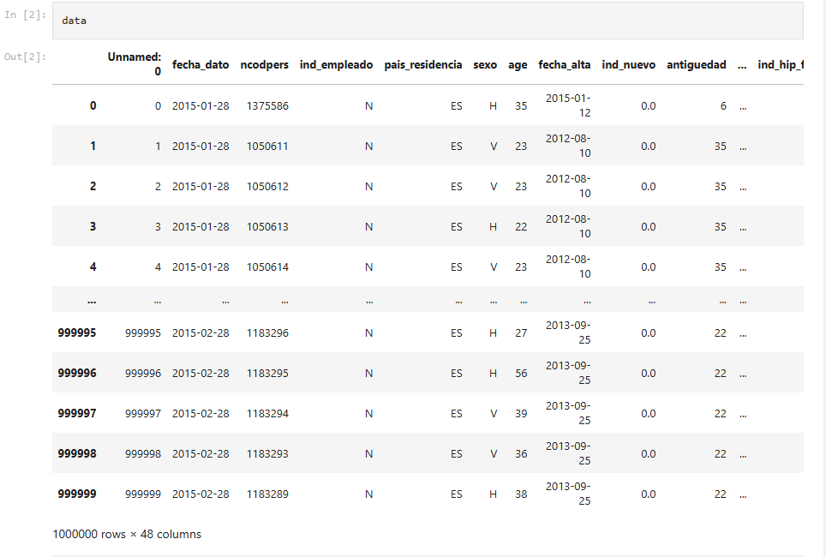
Data Understanding
The dataset consists of 48 columns and 1000000 rows.

Slide 11
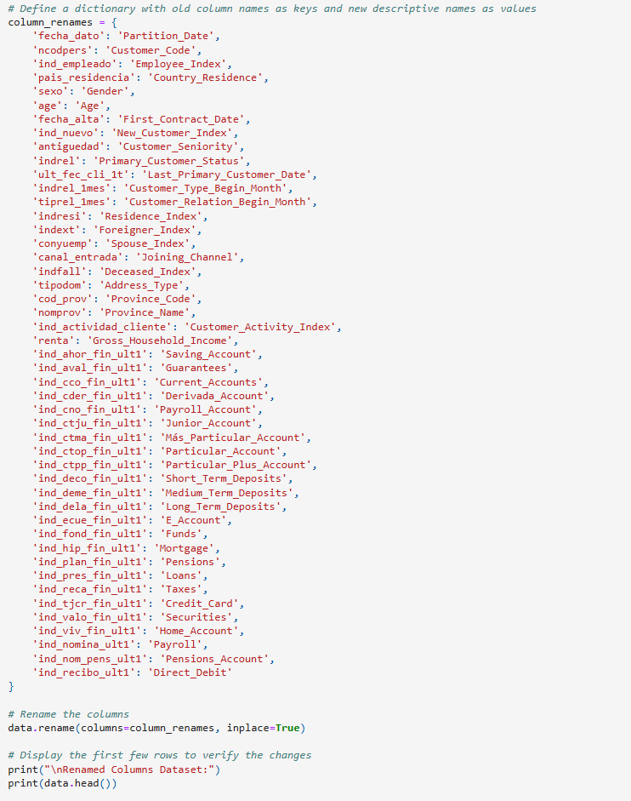
Data Preprocessing – Column Renaming

Slide 12
Data Preprocessing – Column Renaming
Objective: To enhance dataset clarity and interpretability by renaming columns with
meaningful and descriptive names.
Key Highlights:
Column Standardization:
Original dataset contained ambiguous column names.
Renamed columns to improve readability and facilitate analysis.
Benefits: ✔ Enhanced data readability for stakeholders. ✔ Improved consistency in variable naming across analyses. ✔ Facilitates efficient feature engineering and model building.

Slide 13
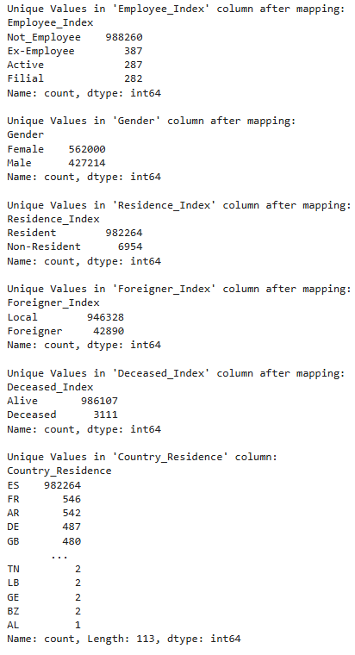
Data Transformation – Value Mapping
Objective: To enhance data interpretability by mapping categorical codes to meaningful labels for key attributes.
Key Highlights:
Mapping Approach:
Transformed categorical values into human-readable labels to facilitate analysis and reporting.

Slide 14
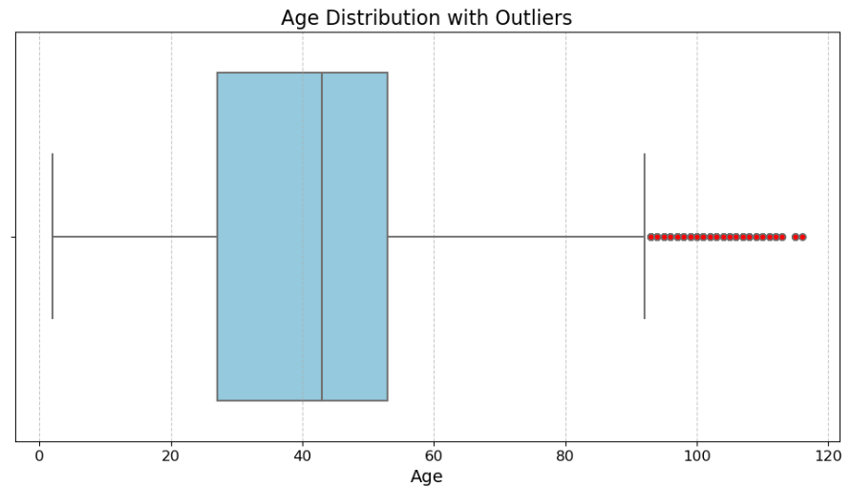
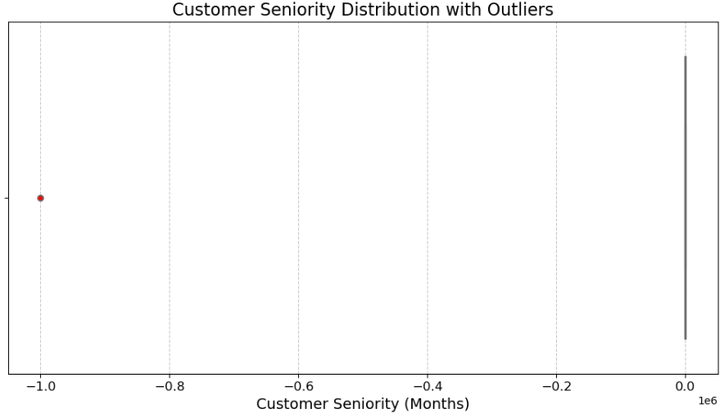
Outlier Detection Using Boxplots
Age Distribution Analysis:
Boxplot visualization revealed potential outliers.
Majority of the customers are within a normal range (25 -55), but a few extreme values were identified.
Red markers indicate possible data anomalies requiring further inspection.
Customer Seniority Analysis:
Seniority data contains outliers, potentially due to data entry errors or special cases (e.g., long-term customers).
Helps in defining capping or transformation strategies to handle extreme values.

Slide 15
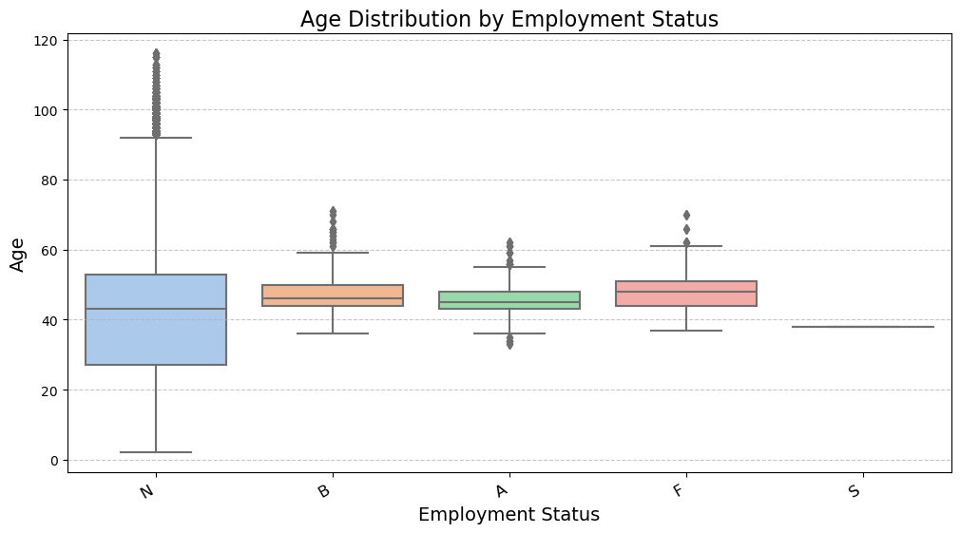
Age Distribution by Employment Status
Analysis:
A boxplot was generated to compare age distribution across different employment categories (employee index: A active, B ex employed, F filial, N not employed, P passive) The distribution highlights variations in customer demographics based on employment type.
Key Observations:
Active employees tend to have a narrower age range, with a higher concentration in mid-age groups.
Ex-Employees show a higher median age, indicating they might be retirees or long-term customers.
Outliers (marked by dots) suggest a few customers with unusual age values in specific categories.

Slide 16
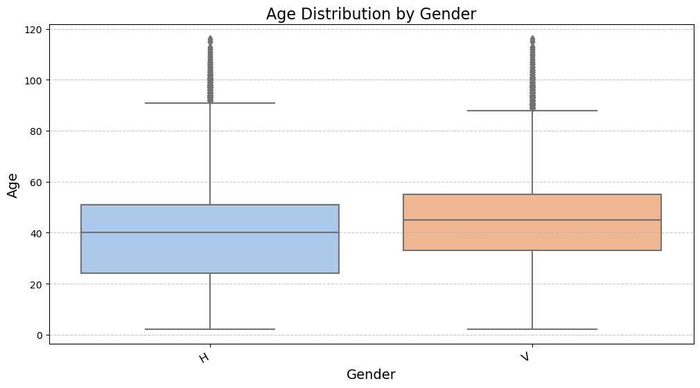
Age Distribution by Gender
Analysis:
A gender-based age comparison was conducted using a boxplot to identify trends between male and female customers.
The visualization helps in understanding whether age distribution varies significantly across genders.
Key Observations:
Median age is slightly higher for female (V) customers compared to male (H) customers.
Both genders have similar spread, but male customers show a few more age outliers.
The distribution is relatively symmetrical, with no significant skewness observed.

Slide 17
Summary of Missing Values
Key Observations:
Critical missing values:
Fields such as Last_Primary_Customer_Date and Spouse_Index have nearly complete data loss, which might indicate data redundancy or non-relevance for analysis.
Missing Gross_Household_Income could impact financial insights.
Low missing percentages:
Columns like Province_Code, Payroll, and Gender have minimal missing data, making them suitable for simple imputation.

Slide 18
Summary of Missing Values
Categorical Data Handling:
Missing values in key categorical columns (Employee_Index, Gender, Joining_Channel) were imputed using the most frequent value (mode).
This ensures consistency and preserves data integrity.
Numerical Data Handling:
Columns with numerical data such as Gross_Household_Income, Payroll, and Pensions_Account were imputed using the median value to prevent skewing the data distribution.
The median is a robust measure against outliers.
Location-Based Data Handling:
Missing values in Province_Code and Province_Name were replaced using the most frequent value of Country_Residence.
This approach maintains geographical consistency.
Column Removal:
The columns Last_Primary_Customer_Date and Spouse_Index were dropped due to a high percentage of missing values, reducing noise in the dataset.
Post-Imputation Check:
A final validation confirmed that all missing values were successfully handled, ensuring a clean dataset for further analysis.

Slide 19
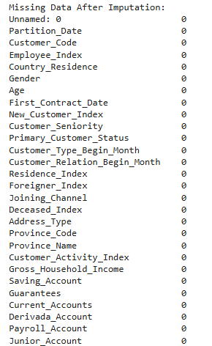
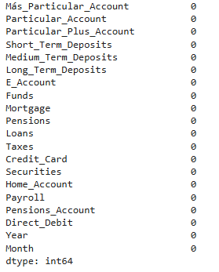
Summary of Missing Values

Slide 20
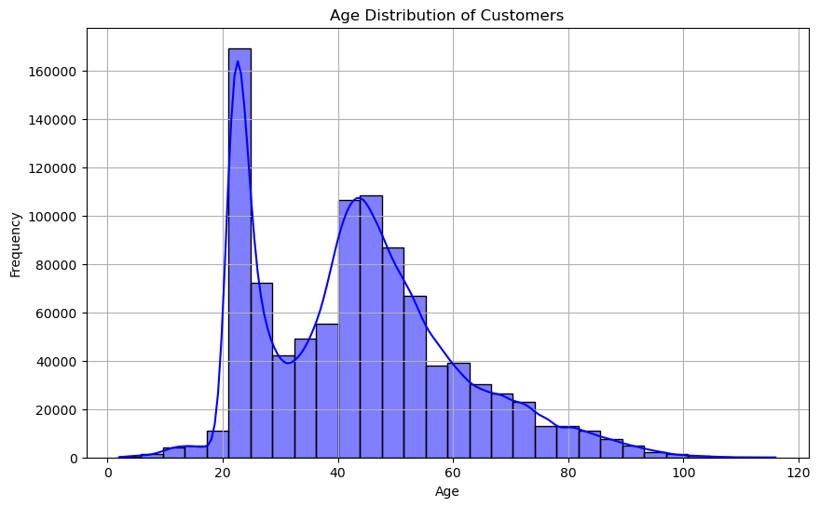
Data Visualization after handling missing data
This provides insights into the age demographics of the customer base.
Key observations: Most of the customers are between the range of 20 and 60.

Slide 21
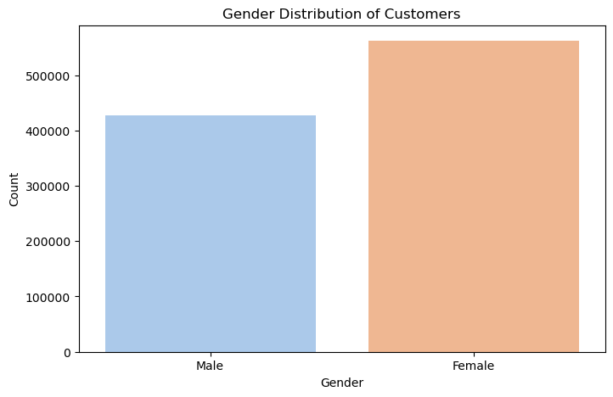
Data Visualization after handling missing data
A count plot was used to visualize the proportion of male and female customers.
There are more Female customers than Male customers

Slide 22
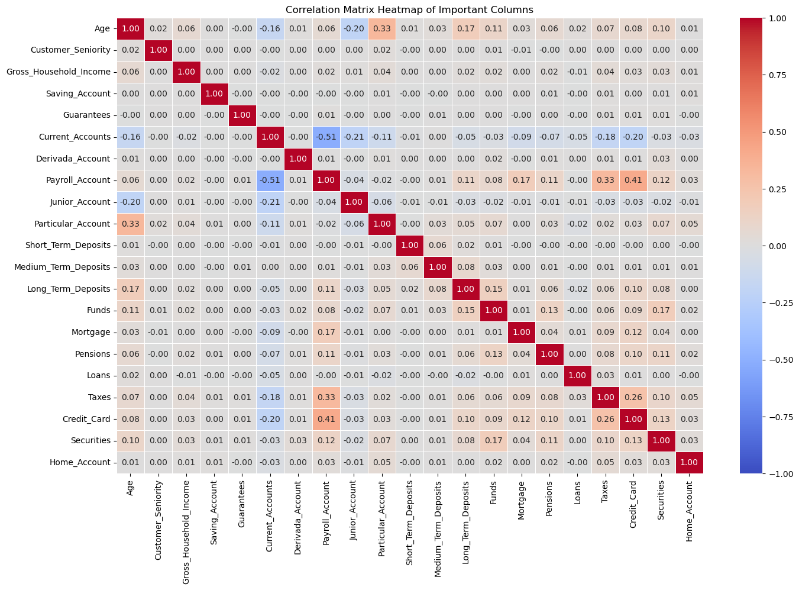
Data Visualization after handling missing data
Correlation Matrix Heatmap:
Purpose: The correlation matrix was created to analyze the relationships between key numerical variables within the dataset.
Visual Representation: A heatmap was used to visualize the strength and direction of correlations between different financial products and customer attributes (e.g., Age, Customer Seniority, Gross Household Income).

Slide 23
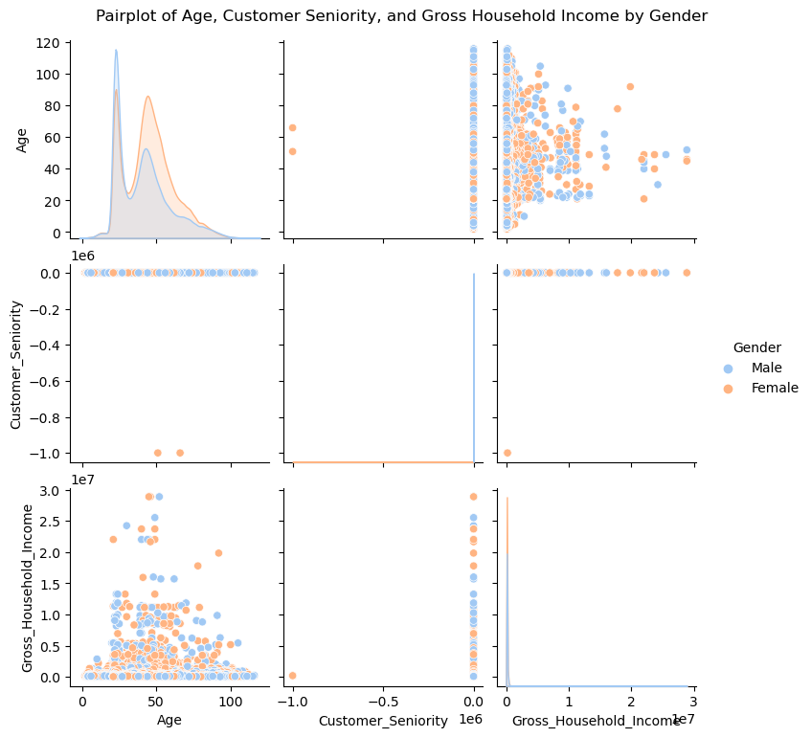
Pairplot of Age, Customer Seniority, and Gross Household Income by Gender

Slide 24
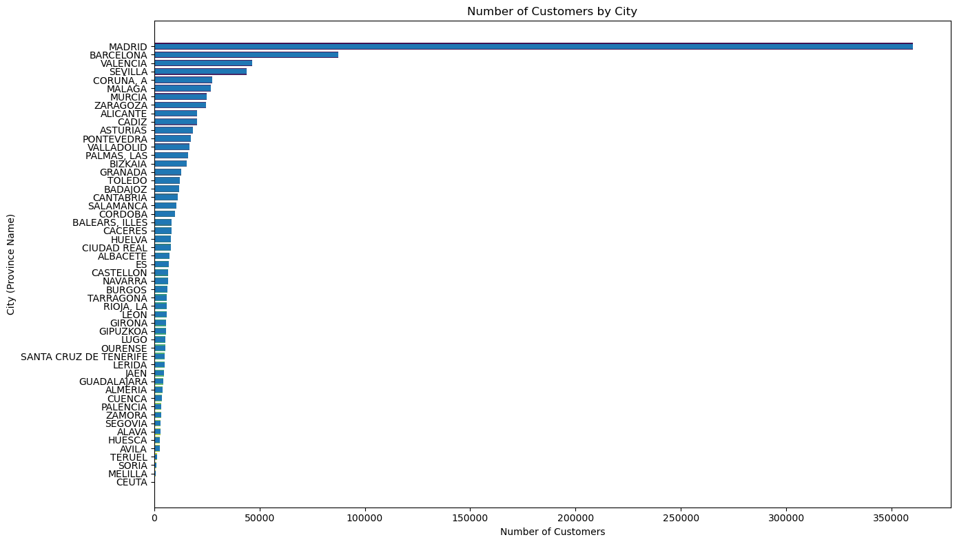
Number of Customers by City
This chart helps in identifying trends in customer distribution and is valuable for regional business planning.
Madrid, Barcelona and Valencia have the most customers by city.

Slide 25
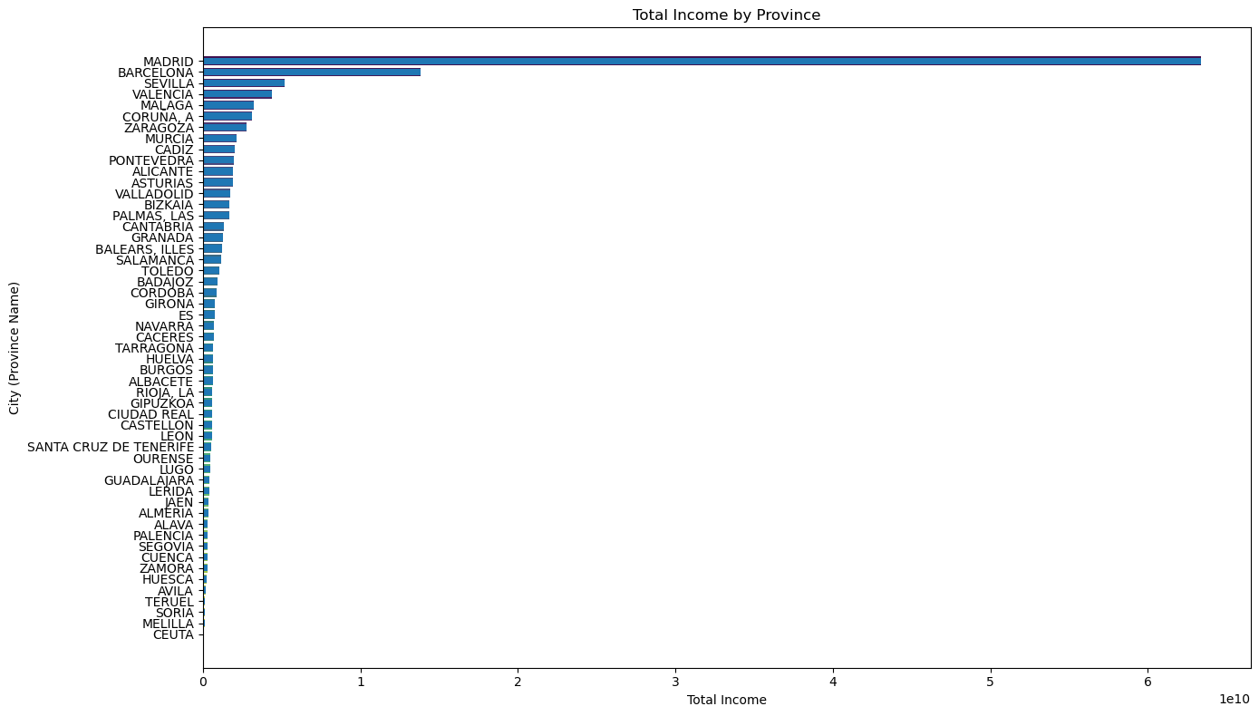
Total Income by Province
Madrid, Barcelona and Sevilla have the most income by Province.

Slide 26
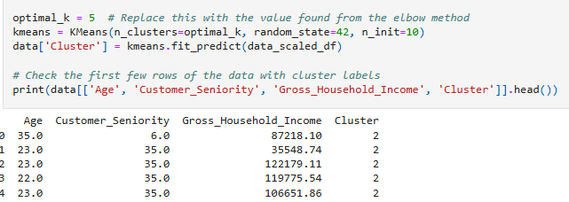
Summary of K-Means Clustering Results
Objective:The K-Means clustering algorithm was applied to segment customers based on key financial and demographic attributes. The optimal number of clusters (k = 5) was determined using the Elbow Method, balancing inertia reduction with interpretability.Clustering Process:Key Features Used:Age – Customer's age.Customer_Seniority – Number of months as a customer.Gross_Household_Income – Estimated annual income. Cluster Assignment:Customers were assigned to one of the 5 clusters.The K-Means model groups customers with similar characteristics into the same cluster.
Key Insights:
Customers within Cluster 2 exhibit a wide range of incomes but similar seniority.
Different clusters may represent varying financial behaviors, tenure levels, and demographics.
This clustering can be used to tailor marketing strategies, product offerings, and customer retention efforts.

Slide 27
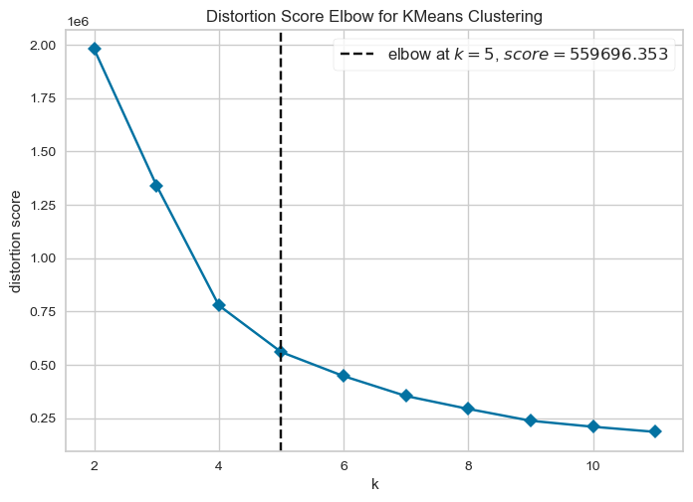
Elbow Method The graph shows that the optimal number of clusters(k) for our model is five.

Slide 28
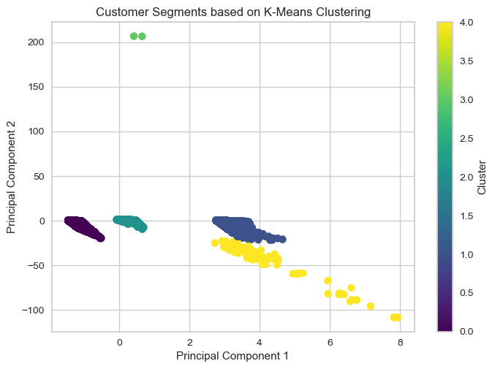
Customer Segments based on K-means Clustering
This visualization helps in understanding how the customer segments are distributed in a 2D space after applying Principal Component Analysis (PCA). The colors represent different clusters obtained from the K-Means algorithm.

Slide 29
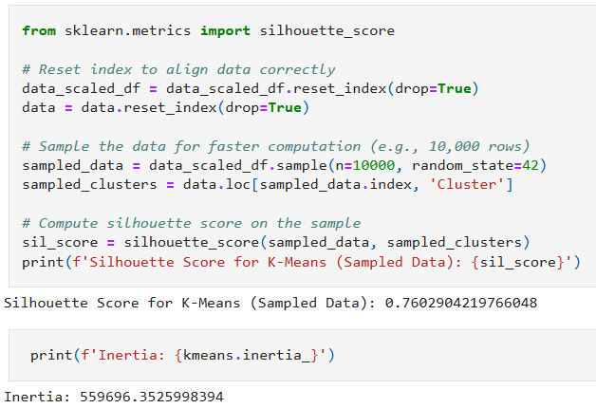
Summary of K-Means Clustering Results
The silhouette score of 0.498 indicates a moderately well-defined clustering structure, meaning that the clusters have reasonable separation and cohesion. The inertia value of 559,698.03 reflects the sum of squared distances of samples to their closest cluster center, indicating the compactness of the clusters.
Silhouette Score (0.76):
A score close to 1 implies well-separated clusters.
A score near 0 suggests overlapping clusters.
A negative score indicates potential misclassification.
Your score suggests decent but not perfect clustering.
Inertia (559,696.35):
Lower inertia values indicate tighter and more compact clusters.
It is useful for comparing different values of kkk (number of clusters).
The Davies-Bouldin Index (DBI) of 0.517 suggests that the clustering structure is relatively well-separated and compact, but there is still room for improvement.

Slide 30
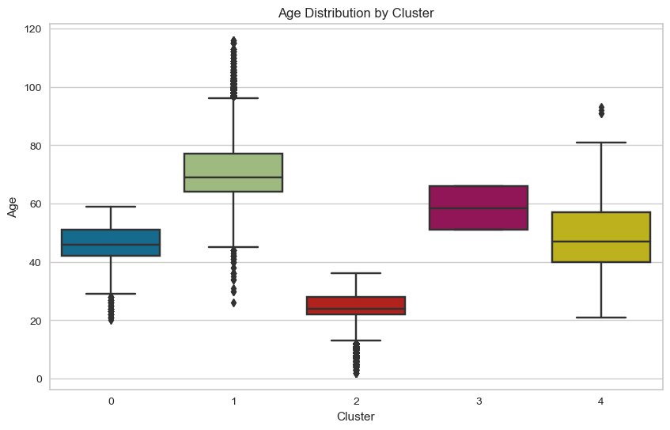
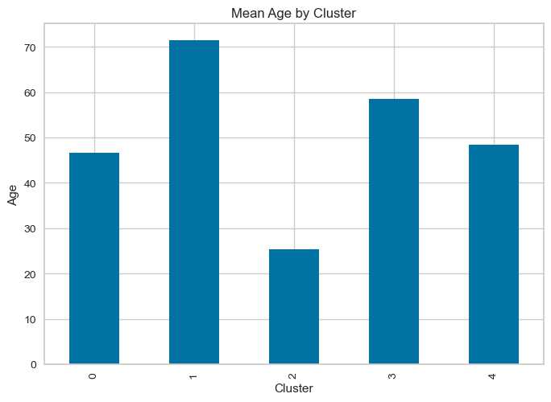
Summary of K-Means Clustering Results
The customer segmentation analysis revealed five distinct clusters based on age, income, and tenure. Younger customers (Cluster 2) have the shortest tenure and moderate incomes, while older customers (Cluster 1) exhibit the longest tenure and higher incomes. Cluster 0 stands out with significantly higher incomes, likely representing high-net-worth individuals. The clustering model achieved a silhouette score of 0.76, indicating reasonably well-separated clusters. These insights can help tailor marketing strategies and customer engagement efforts effectively.

Slide 31
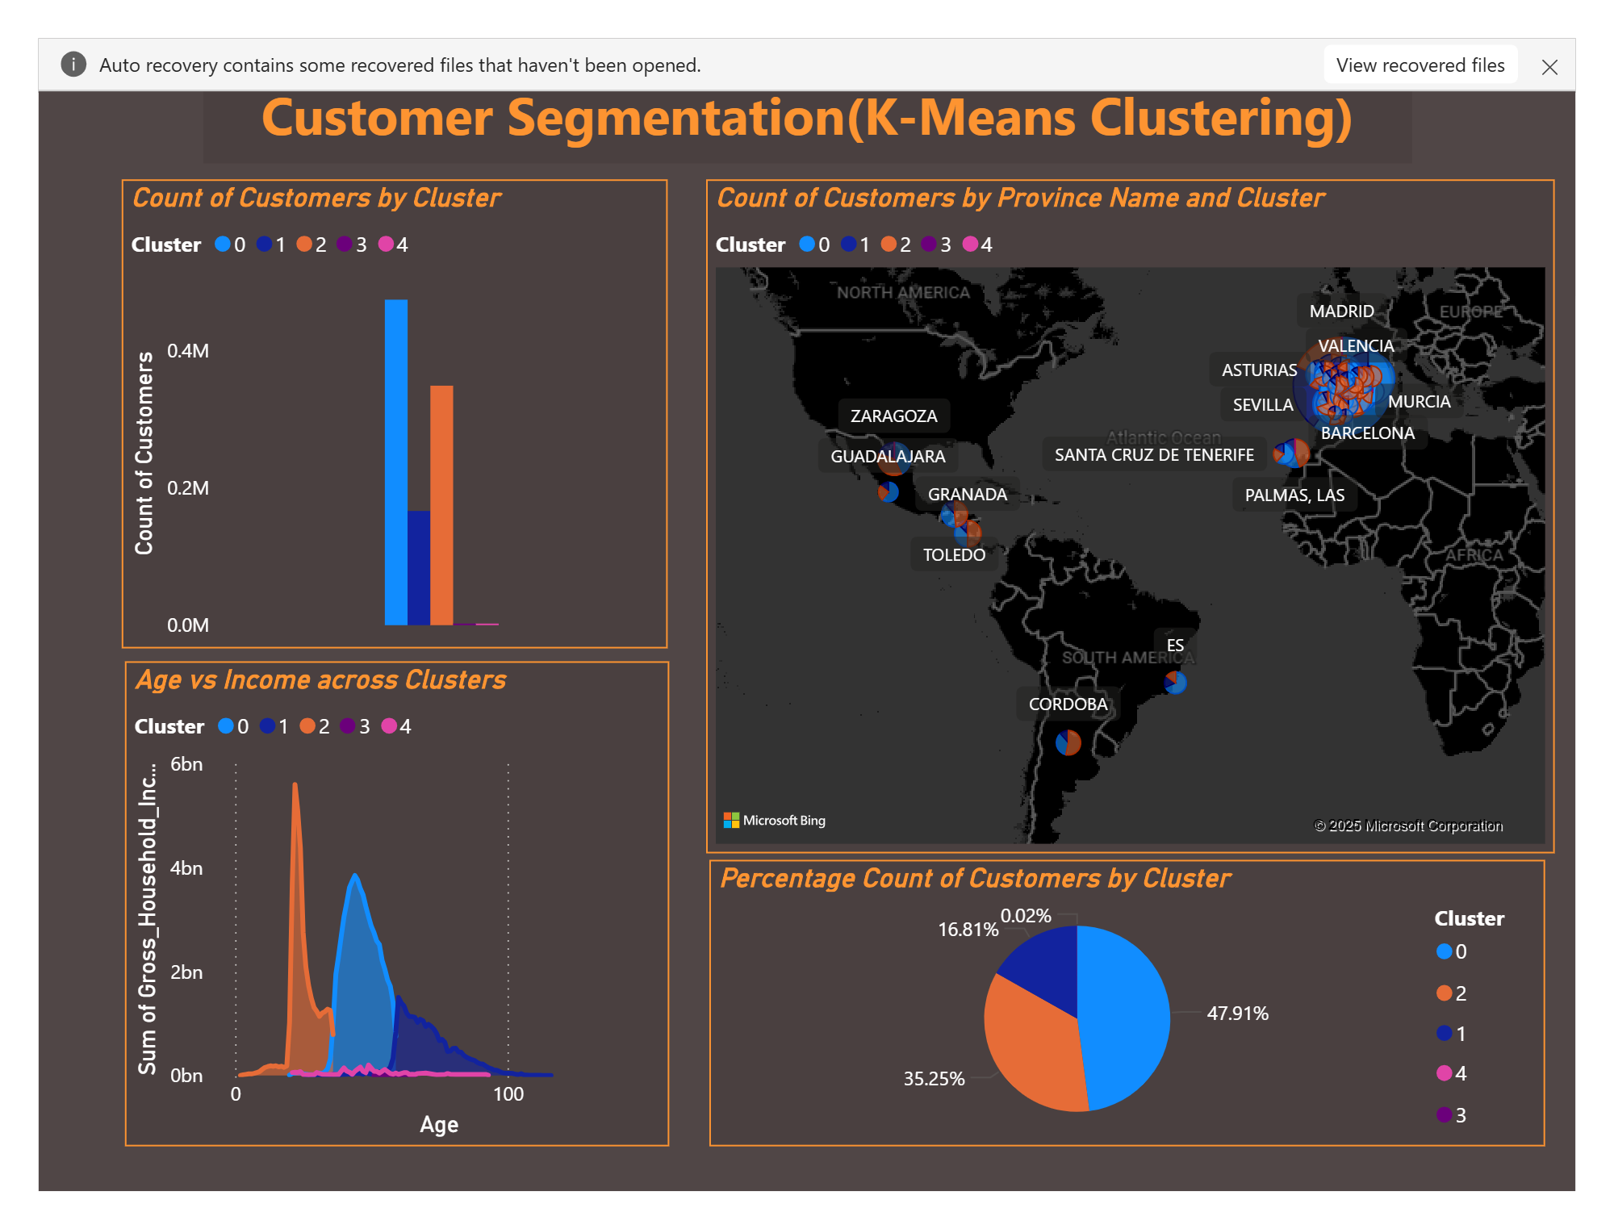
Summary of K-Means Clustering Results
0 group is 48% of all customers, any improvements achieved in this customer group will dramatically benefit the campaign.

Slide 32
Summary of K-Means Clustering Results
The dataset was well-suited for an unsupervised machine learning task. To address this project, the K-Means clustering method was applied alongside PCA, given the dataset's numerous features. The Elbow method was used to determine the optimal number of clusters, which was found to be five. By implementing K-Means clustering, patterns within the data were identified, enabling the creation of distinct groups. This segmentation can facilitate the development of targeted strategies for each group. In the future, specific features from the dataset can be leveraged to form customer groups, allowing for the delivery of personalized offers.

Slide 33
Model Performance Evaluation with Supervised Learning
1. Training a Random Forest Classifier
A Random Forest Classifier was implemented to predict customer groups using supervised learning. The model was trained on labeled data, and its performance was evaluated using accuracy scores, precision, recall, and F1-score. The Random Forest classifier achieved near-perfect accuracy, with a classification report showing strong results across all categories.
2. Training an XGBoost Classifier
XGBoost, another powerful ensemble learning algorithm, was also trained for comparison. After fitting the model to the dataset, evaluation metrics revealed high accuracy but a slightly lower performance compared to Random Forest, particularly in handling class imbalances.
3. Hyperparameter Optimization
To enhance model performance, hyperparameter tuning was conducted using RandomizedSearchCV. This was applied to both Random Forest and XGBoost to identify the best parameters for improving accuracy. The optimized Random Forest model achieved a final accuracy of 99.99%, while the optimized XGBoost model reached 99.94%.

Slide 34
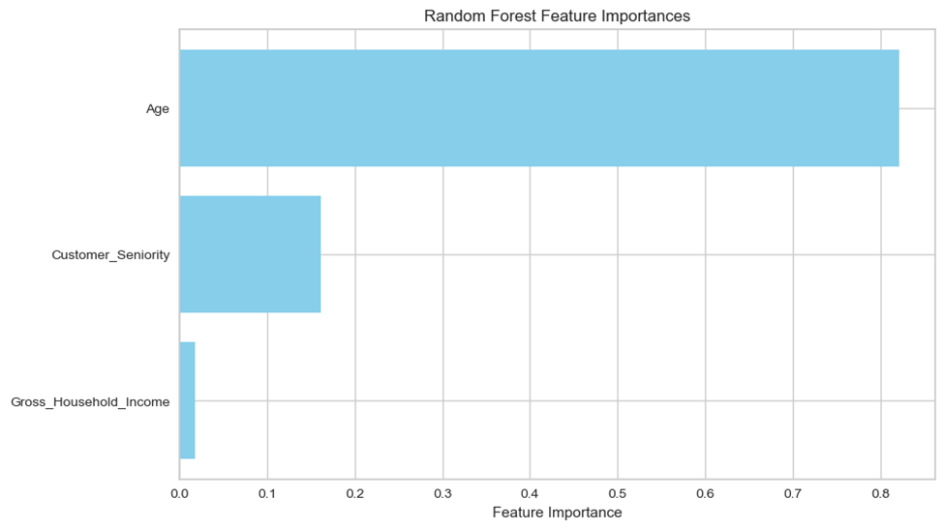
Model Performance Evaluation with Supervised Learning
4. Model Comparison and Selection
A direct comparison of both models showed that Random Forest performed better than XGBoost in terms of accuracy and classification metrics. The confusion matrix revealed that XGBoost had some misclassifications in specific clusters, while Random Forest demonstrated near-perfect classification across all groups.
5. Saving, Loading and Making Predictions
To ensure efficient deployment, the best-performing model was saved using joblib. The saved model was later reloaded and tested on new data. Predictions were generated on a subset of unseen data (first five samples of X_test), confirming that the model remained functional after being saved and reloaded.
6. Feature Importance Analysis
To understand which features contributed the most to the classification, feature importance scores were extracted from the trained Random Forest model. A horizontal bar plot was generated to visualize the most influential features, helping to interpret the model’s decision-making process.

Slide 35
Conclusion
This project utilized machine learning for data analysis and classification, applying both unsupervised (K-Means with PCA) and supervised (Random Forest & XGBoost) techniques. K-Means clustering revealed hidden patterns, with the Elbow Method determining the optimal cluster count.
For classification, Random Forest and XGBoost were optimized through hyperparameter tuning, with Random Forest achieving the highest accuracy and chosen as the final model. The best model was saved and deployed for scalability, and feature importance analysis provided insights into key predictive factors.
The project highlighted the effectiveness of machine learning in data-driven decision-making, supporting personalized strategies and improved segmentation. Future work may involve further tuning, additional features, or deep learning techniques for enhanced performance.

Slide 36
Thank You

